Slide 1
Supply chain analysis
CDACL - 003
K. MOHAN CHAND
E. ROHINI KUMAR

Slide 2
Introduction
Supply chain analysis is the process of evaluating and improving the efficiency and effectiveness of a company's supply chain. It involves examining various components, such as product types, pricing, stock levels, order quantities, shipping times, and supplier information. By analyzing these elements, companies can optimize their operations, reduce costs, and ensure timely delivery of products to customers.

Slide 3
Flow chart of supply chain
> The process flows from suppliers to manufacturing, inventory management, sales, shipping .
1. Supplier & Procurement Phase
SUPPLIER SELECTION
PRODUCTION PLANNING
QUALITY CONTROL
Inspect raw materials .
Track the Defect Rates to Identify supplier or production issues.
Choose a supplier (Supplier Name) based on Location and Lead Time (time to deliver raw materials).
Place an Order Quantity for raw materials.
Determine Production Volumes based on demand forecasts.
Calculate Manufacturing Lead Time (time to produce goods) and Manufacturing Costs.

Slide 4
Flow chart of supply chain
> The process flows from suppliers to manufacturing, inventory management, sales, shipping .
2. Manufacturing Phase
PRODUCTION
QUALITY CHECK
Manufacture products (Product Type, SKU) based on Production Volumes.
Track time (Manufacturing Lead Time) and costs (Manufacturing Costs).
Record Inspection Results and Defect Rates for each batch.

Slide 5
Flow chart of supply chain
> The process flows from suppliers to manufacturing, inventory management, sales, shipping .
3. Inventory Management Phase
STOCK MONITORING
REPLENISHMENT
Track Stock Levels and Availability in warehouses (Location).
Reorder products based on Lead Time (time to restock) to avoid stockouts.

Slide 6
Flow chart of supply chain
> The process flows from suppliers to manufacturing, inventory management, sales, shipping .
4. Sales & Order Fulfillment Phase
SALES
CUSTOMER INSIGHTS
Sell products (Product Type, SKU) at a Price.
Track Number of Products Sold and Revenue Generated (Price × Quantity Sold).
Analyze Customer Demographics (age, location) to tailor marketing strategies.

Slide 7
Flow chart of supply chain
> The process flows from suppliers to manufacturing, inventory management, sales, shipping .
5. Shipping & Logistics Phase
SHIPPING SETUP
DELIVERY
Choose Shipping Carriers (e.g., FedEx) and Transportation Modes (air, truck).
Define Routes and calculate Shipping Costs.
Ship products to customers within Shipping Times (e.g., 3 days).
Track Location (origin / destination) for logistics optimization.

Slide 8
Supply & PROCUREMENT PHASE ANALYSIS

Slide 9
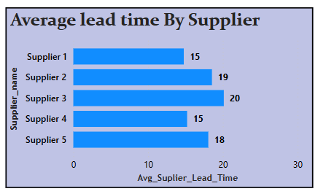
Supply & Procurement phase analysis
1. Average Supplier Lead time By Supplier
The bar chart titled “Average lead time by Supplier" provides valuable insights into supplier performance based on lead time.
Supplier 2 and supplier 3 have the highest lead times at 19 and 20 days, respectively, indicating potential inefficiencies or delays in their processes.
In contrast, supplier 1 and supplier 4 have the lowest lead times at 15 days, suggesting they are more reliable and quicker in fulfilling orders. Supplier 5's lead time of 18 days is moderate but could still be improved.
This analysis can help in making strategic decisions, such as negotiating better terms with suppliers, improving supply chain processes, or even reconsidering supplier partnerships to ensure timely delivery and efficiency.
Fig 1 . Average Supplier Lead Time By Supplier

Slide 10
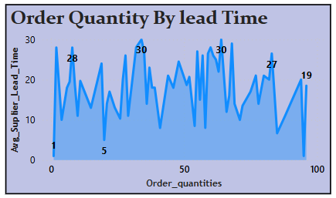
Supply & Procurement phase analysis
2. Order Quantity By Supplier Lead Time
The area chart titled “Order quantity by Supplier lead time" provides an insightful look into the relationship between order quantities and average supplier lead time.
The chart shows that Order Quantities of 30 and 50 have the longest lead times at 30 days each. The shortest lead time of 1 day is observed when the order quantity is 1.
Lead times fluctuate significantly across different order quantities, showing no clear pattern. Larger orders, particularly at 30 and 50, face delays likely due to bottlenecks, while smaller orders are fulfilled quickly due to less complexity.
Analyzing this data, it’s clear that optimizing order sizes and improving supplier collaboration can reduce delays.
Fig 2 . Order Quantity By Supplier Lead Time

Slide 11
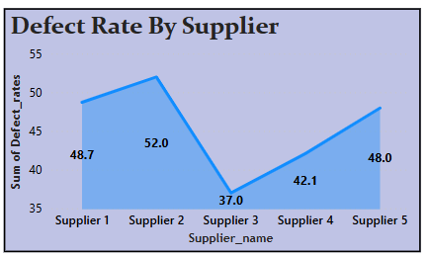
Supply & Procurement phase analysis
3. DEFECT RATES BY SUPPLIER NAME
The stacked area chart titled "Defect Rate By Supplier" provides an insightful look into the defect rates for five different suppliers.
The chart shows that Supplier 2 has the highest defect rate at 52.0, followed by Supplier 1 at 48.7 and Supplier 5 at 48.0.
On the lower end, Supplier 3 has the lowest defect rate at 37.0, with Supplier 4 at 42.1.
The defect rates vary significantly among suppliers, highlighting discrepancies in quality. Identifying and addressing the causes behind these variations can help improve overall product quality and supplier performance.
By collaborating closely with suppliers and implementing quality control measures, businesses can reduce defect rates and enhance customer satisfaction.
Fig 3 . Defect Rates By Supplier Name

Slide 12
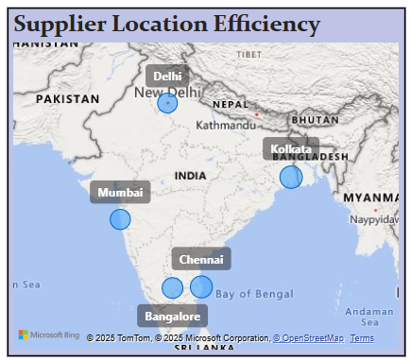
Supply & Procurement phase analysis
4. Average Supplier Lead Time By City
The bubble chart titled “Avg Supplier Lead Time by City" provides an insightful look into the average supplier lead times across various cities in India.
The bubble sizes represent the Average lead times, with Delhi at 14.6 days, Mumbai at 15.31 days, Bangalore at 16.2 days, Chennai at 18.26 days, and Kolkata at 44 days.
The largest bubble is for Kolkata, indicating the highest lead time of 44 days, whereas the smallest bubble is for Delhi, with the lowest lead time of 14.6 days.
These significant variations highlight the efficiency and challenges faced by suppliers in different locations. Identifying and addressing the factors contributing to these discrepancies can help improve overall supplier performance and reduce lead times.
Fig 4 . Average Supplier Lead Time By City

Slide 13
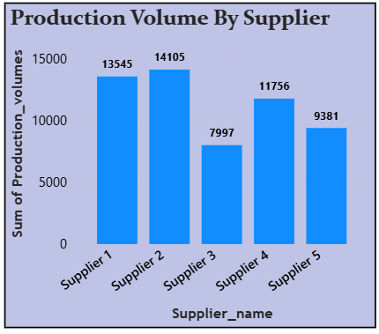
Supply & Procurement phase analysis
5. Production volume by Supplier
The bar chart titled "Production Volume By Supplier" provides an insightful look into the sum of production volumes across different suppliers.
The chart shows that Supplier 2 has the highest production volume at 14,105, followed by Supplier 1 at 13,545.
Supplier 4 comes next with a production volume of 11,756, while Supplier 5 has 9,381. Supplier 3 has the lowest production volume at 7,997.
These variations highlight the different capacities and efficiencies of each supplier. Identifying and addressing the factors contributing to these differences can help improve overall production efficiency and supplier performance.
Fig 5. Production Volume By Supplier

Slide 14
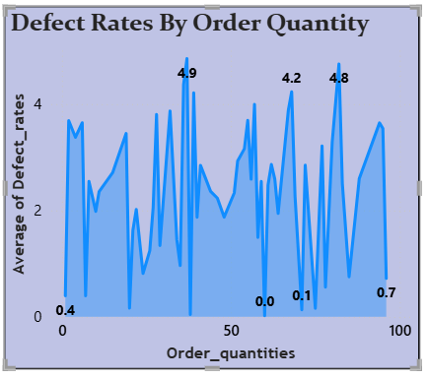
Supply & Procurement phase analysis
6. Defect Rates By Order Quantity
The stacked area chart titled "Defect Rates By Order Quantity" provides an insightful look into the average defect rates across different order quantities.
The chart shows that at order quantity 1, the defect rate is 0.4. At order quantity 38, the defect rate peaks at 4.9, while at 68, it is 4.2.
The defect rate drops significantly at order quantity 71 to 0.1, rises again to 4.8 at order quantity 82, and is 0.7 at order quantity 100.
These fluctuations highlight how defect rates vary with different order quantities.
Identifying and addressing the causes behind these variations can help improve quality control and production efficiency.
Fig 6. Defect Rates By Order Quantity

Slide 15
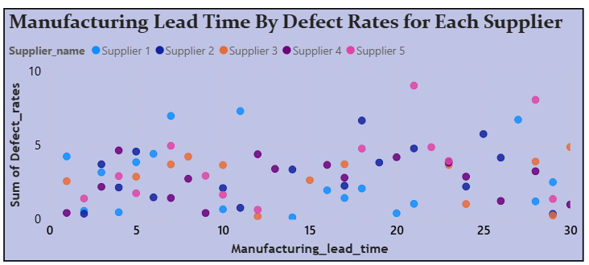
Supply & Procurement phase analysis
7. Manufacturing lead time by defect rates
The scatter plot titled "Manufacturing Lead Time By Defect Rates for Each Supplier" provides valuable insights into the relationship between manufacturing lead time and defect rates for each supplier.
The data points represent five different suppliers: Supplier 1 (blue), Supplier 2 (purple), Supplier 3 (orange), Supplier 4 (pink), and Supplier 5 (light blue).
Supplier 1 (blue) generally has shorter lead times and lower defect rates, indicating efficient processes. In contrast, Supplier 2 (purple) tends to have higher lead times and defect rates, suggesting potential inefficiencies. Identifying these patterns helps in strategic planning and supplier selection, allowing companies to focus on suppliers with efficient manufacturing processes and lower defect rates to enhance overall supply chain performance.
Fig 7. Manufacturing Lead time By Defect Rates

Slide 16
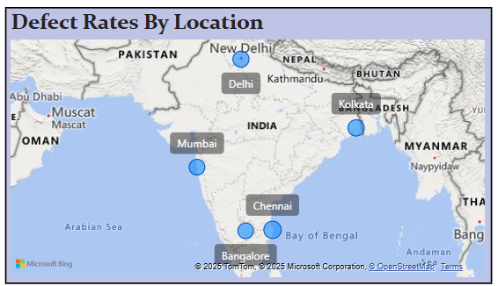
Supply & Procurement phase analysis
8. DEFECT RATES BY LOCATION
The map titled "Defect Rates By Location" highlights the average defect rates across major cities in India.
Chennai has the highest defect rate at 2.63, indicating potential quality control issues that need to be addressed. Kolkata follows with a defect rate of 2.28, and Delhi has a similar rate at 2.26. Mumbai and Bangalore have relatively lower defect rates at 2.12 and 2.09 respectively.
These variations suggest that Chennai and Kolkata may have more significant quality challenges compared to other cities. Identifying the root causes of these higher defect rates can help in implementing targeted quality improvement measures.
By doing so, companies can enhance overall product quality and supplier performance in these regions.
Fig 8. Defect Rates By Location

Slide 17
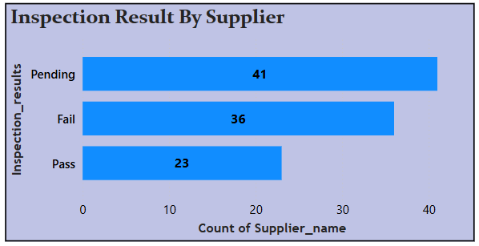
Supply & Procurement phase analysis
9. Inspection result by supplier
The horizontal bar chart titled "Inspection Result By Supplier" provides a detailed analysis of the distribution of inspection outcomes across various suppliers.
The "Pending" category, with 41 suppliers awaiting inspection results. This large number indicates a backlog in the inspection process, which may require streamlining to ensure timely evaluation. The "Fail" category, with 36 suppliers, highlights areas where quality standards are not being met, indicating the need for rigorous quality control measures and supplier improvement initiatives. The "Pass" category, comprising 23 suppliers, showcases suppliers that meet the required standards, reflecting their reliability and adherence to quality expectations.
Focusing on converting pending inspections to successful outcomes and reducing the number of failed inspections can lead to enhanced supplier performance and overall product quality. This distribution emphasizes the importance of thorough inspections and quality control in maintaining an efficient and reliable supply chain.
Fig 9. Inspection Result By Supplier

Slide 18
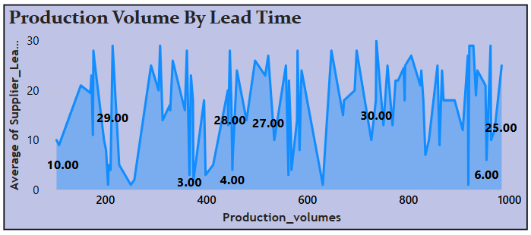
Supply & Procurement phase analysis
10. Production volume by Supplier lead time
The line chart titled "Production Volume By Lead Time" illustrates the relationship between production volumes and average supplier lead times.
The chart reveals that certain production volumes, such as around 100 and 300 units, have relatively low lead times of 10 and 3 days, respectively. However, for other production volumes, such as around 200, 400, 500, and 700 units, the lead times are significantly higher, reaching up to 29 or 30 days.
The fluctuations in lead times across different production volumes indicate potential inefficiencies and bottlenecks at specific production levels. Understanding and addressing these factors can help optimize supply chain performance, improve overall efficiency, and reduce delays.
Fig 10. Production Volume By Avg Lead Time

Slide 19
Manufacturing PHASE ANALYSIS

Slide 20
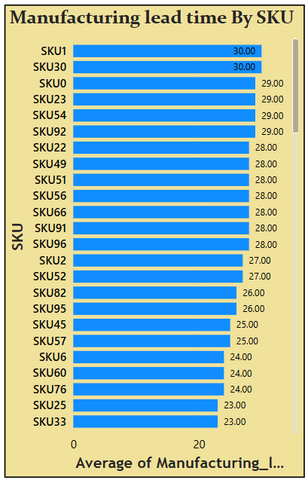
Manufacturing phase analysis
1. Manufacturing Lead time by sku
The bar chart shows the “Average manufacturing lead time for various SKUs” (Stock Keeping Units).
SKU1 and SKU30 have the highest lead time at 30 days, indicating potential production bottlenecks. SKU33 has the lowest lead time at 23 days, suggesting a more streamlined process.
Consistent lead times, like 30 days for SKU1 and SKU30, and 24 days for SKU20 and SKU21, hint at standardized production processes. The variability in lead times, ranging from 23 to 30 days, points to differences in complexity or production challenges.
Higher lead times may indicate bottlenecks, whereas shorter ones can serve as efficiency benchmarks. Clustering SKUs with similar lead times, such as those at 28 days, can help in targeted process improvements. Identifying these insights aids in better inventory management, production planning, and overall process optimization.
Fig 11. Manufacturing lead time By SKU

Slide 21
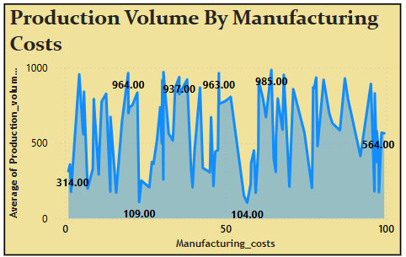
Manufacturing phase analysis
2. Production volume by manufacturing cost
The are chart titled "Production Volume By Manufacturing Costs" displays the relationship between manufacturing costs and average production volume.
The production volume fluctuates significantly with changes in manufacturing costs. At a manufacturing cost of 1.09, the production volume starts at 314, then peaks at 964 at a cost of 19.71, and continues to vary at other cost values. There are noticeable peaks at certain cost points, such as 964 at cost 19.71 and 985 at cost 64.32, indicating optimal cost points for production efficiency.
Conversely, there are troughs at other cost points, like 564 at cost 98.61, which may suggest inefficiencies or challenges. The high production volume at lower costs indicates areas where production is more efficient, and understanding the reasons behind significant drops in production volume can help improve the production process. This graph provides valuable insights for identifying cost-effective production levels and optimizing manufacturing costs.
Fig 12. Production Volume By Manufacturing cost

Slide 22
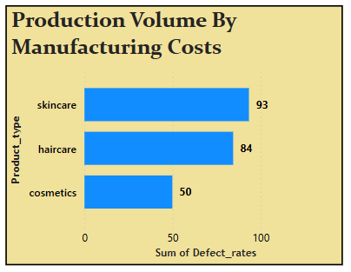
Manufacturing phase analysis
3. Production Volume By manufacturing cost
The bar chart titled "Sum of Defect Rates by Product Type" displays defect rates for three product types: skincare, haircare, and cosmetics.
From this chart, we can observe that skincare products have the highest defect rate at 93, followed by haircare products at 84, and cosmetics have the lowest defect rate at 50.
This indicates that skincare products are more prone to defects, suggesting potential issues in the manufacturing process or quality control for this category. Haircare products also have a relatively high defect rate, though not as high as skincare. In contrast, cosmetics have the lowest defect rate, indicating better manufacturing consistency and quality control measures
This analysis can help identify areas for improvement in the production processes of skincare and haircare products to achieve higher quality standards and reduce defect rates. Additionally, cosmetics have the lowest defect rate can provide insights into best practices that can be applied to other product types.
Fig 13. Production Volume By Manufacturing cost

Slide 23
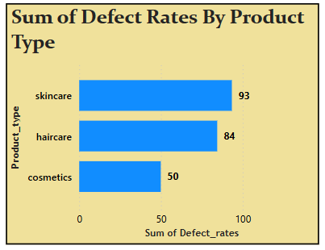
Manufacturing phase analysis
4. Sum of defect rates by product type
The bar chart titled "Sum of Defect Rates by Product Type" displays defect rates for three product types: skincare, haircare, and cosmetics.
From this chart, we can observe that skincare products have the highest defect rate at 93, followed by haircare products at 84, and cosmetics have the lowest defect rate at 50.
This indicates that skincare products are more prone to defects, suggesting potential issues in the manufacturing process or quality control for this category. Haircare products also have a relatively high defect rate, though not as high as skincare. In contrast, cosmetics have the lowest defect rate, indicating better manufacturing consistency and quality control measures
This analysis can help identify areas for improvement in the production processes of skincare and haircare products to achieve higher quality standards and reduce defect rates. Additionally, cosmetics have the lowest defect rate can provide insights into best practices that can be applied to other product types.
Fig 14. Defect rates By Product type

Slide 24
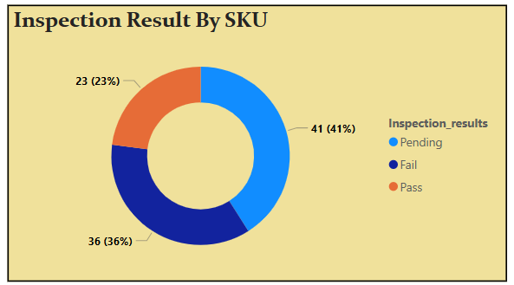
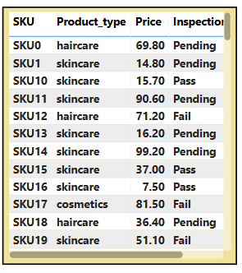
Manufacturing phase analysis
5. Inspection Result By SKU
The donut chart titled "Inspection Results by SKU" visualizes the inspection outcomes for various products. On the left side, the pie chart segments the inspection results into three categories: "Pending," "Fail," and "Pass."
The majority of the SKUs (41%) are still pending inspection, while a significant portion (36%) have failed, and a smaller portion (23%) have passed.
On the right side, the table details 12 SKUs, including their product type, price, and inspection status. The inspection results highlight that skincare products are prominently present in all three categories, indicating variable quality control within this product type. Haircare and cosmetics also appear, with cosmetics having notable pass and fail results.
This analysis can help identify areas for improvement in the inspection process, focusing on the high failure rates and the large number of pending SKUs.
Fig 15. Inspection Result By SKU & Table

Slide 25
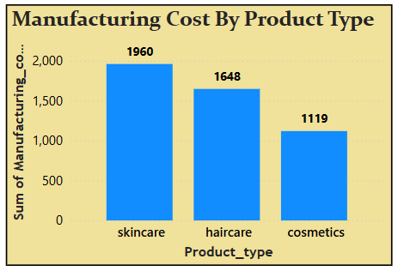
Manufacturing phase analysis
6. Manufacturing cost by product type
The bar chart titled "Manufacturing Cost By Product Type" displays the manufacturing costs for three different product types: skincare, haircare, and cosmetics.
From this chart, it is evident that skincare products have the highest manufacturing cost at 1,960 units. This suggests that skincare products might involve more expensive ingredients, complex production processes, or higher quality control measures.
Haircare products follow with a manufacturing cost of 1,648 units, indicating moderately high production costs, potentially due to specific formulations or packaging requirements. Cosmetics have the lowest manufacturing cost at 1,119 units, suggesting a relatively more straightforward and cost-effective production process.
By understanding these cost differences, companies can identify areas for cost optimization and allocate resources more effectively. Additionally, it can provide insights into pricing strategies and potential areas for cost reduction without compromising product quality.
Fig 16. Manufacturing Cost By Product type

Slide 26
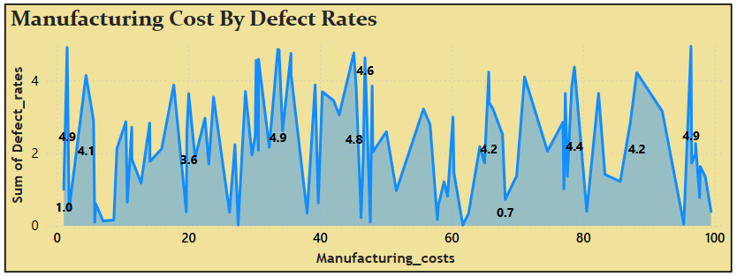
Manufacturing phase analysis
7. Manufacturing cost by DEFect rates
The are chart titled "Manufacturing Cost By Defect Rates" displays the relationship between manufacturing costs (ranging from 0 to 100) and defect rates (ranging from 0 to 5).
Initially, at lower manufacturing costs, the defect rates are relatively high, with a value of 4.9 at a cost of 1.61 and 4.1 at a cost of 4.47. As manufacturing costs increase, defect rates show considerable fluctuation, indicating that higher costs do not always correlate with lower defect rates.
However, a significant drop in defect rates to 0.7 occurs at a cost of 68.18, suggesting that efficient manufacturing processes might be implemented at this cost level, leading to a reduction in defects.
The variability in defect rates with changing manufacturing costs points to the possibility of different production practices, quality control measures, and materials used at various cost levels. Identifying the optimal cost levels where defect rates are minimized can help improve overall product quality and reduce waste.
Fig 17. Manufacturing Cost By Defect Rates

Slide 27
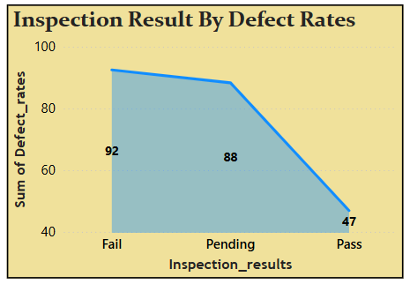
Manufacturing phase analysis
8. Inspection result by Defect rates
The stacked area chart titled "Inspection Result By Defect Rates" shows the relationship between inspection results and the sum of defect rates.
From this graph, we can observe that the sum of defect rates is highest for the "Fail" category at 92, slightly lower for the "Pending" category at 88, and significantly lower for the "Pass" category at 47.
This trend indicates that as inspection results improve from Fail to Pass, the sum of defect rates decreases. This suggests that there is a strong correlation between inspection outcomes and defect rates, with lower defect rates being associated with passing inspections.
This analysis highlights the importance of addressing defects to improve inspection outcomes. By focusing on reducing defect rates, the overall quality of products can be enhanced, leading to more products passing inspection.
Fig 18. Inspection Result By Defect Rates

Slide 28
Manufacturing phase analysis
9. Manufacturing lead time by production volume
The stacked are chart titled "Manufacturing Lead Time By Production Volume" visualizes the relationship between manufacturing lead time and production volume.
It is evident that production volume fluctuates with changes in manufacturing lead time. For instance, at a lead time of 1 days, the production volume is 2055 units. The volume peaks at 4146 units with a lead time of 7 days, suggesting that shorter lead times can result in higher production volumes.
However, as lead time increases to 13 and 19 days, the production volume drops significantly to 535 and 671 units, respectively. there is another peak in production volume at 4178 units with a lead time of 28 days, which could indicate efficient manufacturing processes at this specific lead time. Conversely, other intervals, such as 9 and 25 days, show moderate production volumes of 1500 and 1382 units, respectively.
This analysis suggests that there are certain optimal lead times that result in higher production volumes. Understanding these optimal points can help improve overall manufacturing efficiency. Conversely, identifying intervals with lower production volumes can highlight areas for process improvement. This information is valuable for optimizing production schedules and enhancing manufacturing processes to achieve better efficiency and output.

Slide 29
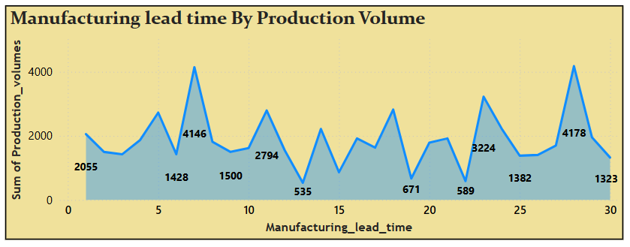
Manufacturing phase analysis
Fig 19. Manufacturing Lead time By Production Volume

Slide 30
Inventory management PHASE ANALYSIS

Slide 31
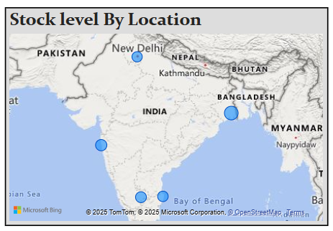
INVENTORY MANGEMENT phase analysis
1. Stock level By location
The map titled "Stock Level By Location" shows the distribution of stock levels across various cities in India. From the data, we can observe that Kolkata has the highest stock level at 1,439 units, indicating a significant concentration of stock in this city. Mumbai follows with 932 units, suggesting a substantial stock presence. Bangalore has a moderate stock level of 832 units, while Chennai has 799 units, slightly lower but still considerable. New Delhi has the lowest stock level among these cities, with 751 units.
This analysis suggests that Kolkata holds the largest share of stock, which could be due to higher demand, strategic distribution centers, or production facilities located in this region. The moderate levels in Mumbai, Bangalore, and Chennai indicate these cities also play crucial roles in stock distribution, possibly serving as regional hubs. New Delhi's lower stock level might suggest a smaller market size or different distribution priorities.
Understanding these stock levels helps in planning logistics, ensuring efficient supply chain management, and addressing regional demands more effectively.
Fig 20. Stock Level By Location

Slide 32
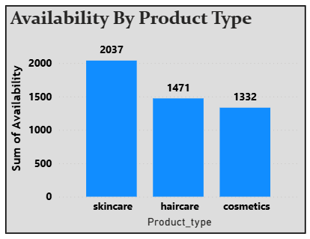
INVENTORY MANGEMENT phase analysis
2. Availability By Product Type
The bar chart titled "Availability By Product Type" shows the sum of availability for three different product types: skincare, haircare, and cosmetics.
From this chart, we can observe that skincare products have the highest availability with a sum of 2037, indicating a significant inventory presence in this category.
Haircare products follow with a sum of 1471, suggesting a moderate level of availability. Cosmetics have the lowest availability among the three product types, with a sum of 1332.
This analysis highlights that skincare products have the most substantial stock levels, which could be due to higher demand, production capacity, or strategic inventory management.
The moderate availability of haircare products suggests a balanced approach to stock levels, potentially based on demand and supply chain considerations. The lower availability of cosmetics might indicate either a lower demand or a more conservative inventory strategy.
Fig 21. Availability By Product Type

Slide 33
INVENTORY MANGEMENT phase analysis
3. Availability By Stock level
The are chart titled "Availability By Stock Level" illustrates the relationship between stock levels and the average availability of items. The graph covers stock levels from 0 to 100 and shows average availability values ranging from 0 to 100.
From the graph, it is evident that the average availability fluctuates significantly across different stock levels. At a stock level of approximately 10, the availability is 29.00, which then drops to 16.00 at a stock level of 12. As stock levels increase to 22, availability peaks at 98.00, indicating that this level is optimal for maximizing item availability. However, the availability drops sharply to 6.00 at a stock level of 36.
The pattern continues with another peak at a stock level of 63, where availability reaches 88.00. This suggests that certain stock levels are more efficient in maintaining item availability. Lower availability values at stock levels like 36, 80, and 92 (6.00, 5.00, and 75.00 respectively) indicate potential inefficiencies or imbalances in stock management.
The graph reveals that there is no consistent trend of increasing or decreasing availability with stock levels. This variability suggests that inventory management practices need to be optimized to ensure a more balanced and efficient approach. Identifying the stock levels that yield higher availability can help in planning and maintaining optimal inventory levels, reducing the risk of overstocking or stockouts.

Slide 34
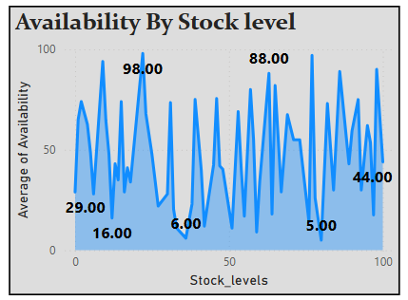
INVENTORY MANGEMENT phase analysis
Fig 22. Availability By Stock Level

Slide 35
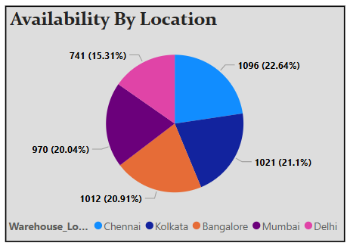
INVENTORY MANGEMENT phase analysis
4. Availability By Location
The pie chart titled "Availability By Location" shows the availability of a resource or item across five different cities in India. Chennai has the highest availability at 1,096 units, which constitutes 22.64% of the total availability. This suggests that Chennai might be a significant hub for this resource, either due to higher demand or strategic distribution.
Kolkata follows closely with 1,021 units (21.1%), indicating another major center of availability. Bangalore has a similar availability level with 1,012 units (20.91%), showing it is also a key location for this resource.
Mumbai, with 970 units (20.04%), and Delhi, with 741 units (15.31%), have slightly lower availability but are still important locations.
This analysis highlights the distribution of the resource across different cities, which can inform logistics, inventory management, and supply chain strategies.
The higher availability in Chennai, Kolkata, and Bangalore suggests these cities may have higher demand or more efficient distribution networks.
Fig 23. Availability By Location

Slide 36
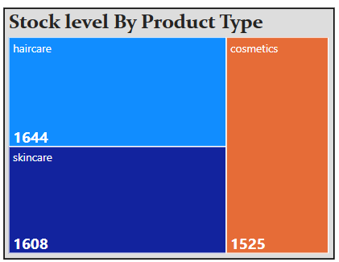
INVENTORY MANGEMENT phase analysis
5. Stock Level By Product type
The tree map titled "Stock Levels By Product type" shows the relationship between stock levels and product types. The tree map is divided into sections representing different product types: haircare, skincare, and cosmetics. Each section's size is proportional to the stock level of that product type.
From the chart, it's observed that haircare has the highest stock level with 1644 units, followed by skincare with 1608 units, and cosmetics with 1525 units. Haircare products are the most stocked, while cosmetics have the lowest stock level.
This analysis is relevant for inventory management and decision-making. It helps understand which product types have higher or lower stock levels, allowing for better planning and resource allocation. For instance, if cosmetics are in high demand but have the lowest stock, it might be necessary to increase inventory for cosmetics to meet customer needs. Conversely, if haircare products are overstocked, it might be beneficial to implement strategies to boost sales or reduce stock levels.
Fig 24. Stock level By Product Type

Slide 37
sales & order Fulfillment PHASE ANALYSIS

Slide 38
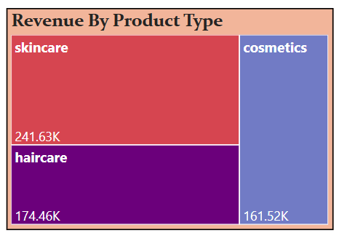
Sales & Order fulfillment phase analysis
1. Revenue By Product type
The tree map chart titled "Revenue By Product Type" provides a visual representation of the revenue generated by three different product types: skincare, haircare, and cosmetics.
The chart demonstrates that skincare products generate the highest revenue, amounting to 241.63K. The large red rectangle emphasizes its dominance in revenue contribution, indicating high demand and importance in the market.
Haircare products come in second, with a revenue of 174.46K. The purple rectangle, while smaller than skincare, still signifies a significant share of the total revenue. This shows that haircare products are also crucial for overall business revenue.
Cosmetics generate the lowest revenue among the three, with 161.52K. The smallest blue rectangle highlights its relatively lower contribution, but still a substantial part of the revenue stream.
By visualizing this data, the tree map helps to quickly identify which product types are performing best in terms of revenue.
Fig 25. Revenue By Product Type

Slide 39
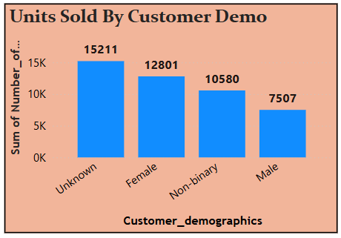
Sales & Order fulfillment phase analysis
2. Units Sold By Customer demograhics
The bar chart titled "Units Sold By Customer Demo" displays the distribution of units sold across various customer demographics. The highest number of units sold is to customers with unknown demographics, totaling 15,211 units. This suggests that a significant portion of sales data lacks detailed demographic information, highlighting an opportunity to improve data collection processes.
Female customers account for the second-highest units sold, with 12,801 units. This indicates a strong preference or demand for the product among female customers. Non-binary customers have purchased 10,580 units, representing a notable portion of the sales. This demographic's presence in the sales data underscores the importance of inclusive marketing and product offerings that cater to diverse customer needs.
Male customers account for 7,507 units, making up the smallest share of units sold among the known demographics. While lower in comparison to other demographics, this segment still contributes significantly to the overall sales and may benefit from targeted marketing efforts to boost engagement.
Fig 26. Units sold By Customer Gender

Slide 40
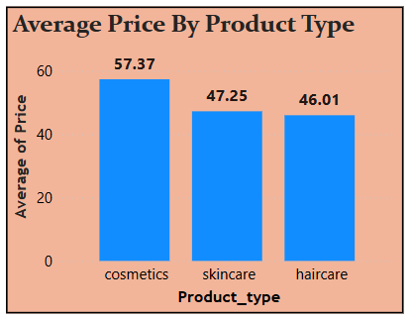
Sales & Order fulfillment phase analysis
3. Average price by product type
The bar chart titled "Average Price By Product Type" provides a visual representation of the average prices of three different product types: cosmetics, skincare, and haircare.
From this chart, cosmetics have the highest average price at 57.37, followed by skincare at 47.25, and then haircare with the lowest average price at 46.01.
This analysis highlights that cosmetics are the most expensive product type on average, indicating a potential higher perceived value or quality. The relatively lower prices of skincare and haircare products suggest that these categories might be more competitively priced or target a different market segment.
It can inform pricing strategies, helping companies position their products appropriately to maximize profitability and appeal to their target customers.
Overall, the chart offers a clear view of the average pricing landscape across different product categories, enabling better-informed decisions for both businesses and consumers in the market.
Fig 27. Average Product By Product Type

Slide 41
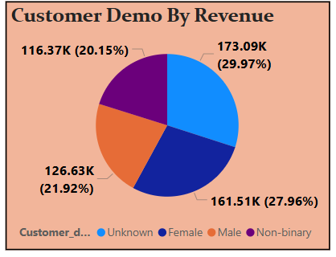
Sales & Order fulfillment phase analysis
4. Customer demographics by revenue
The pie chart titled "Customer Demo By Revenue" provides a visual representation of the revenue generated by different customer demographics.
The Unknown demographic accounts for the highest revenue, totaling 173.09K and representing 29.97% of the total revenue. Female customers generate the second-highest revenue at 161.51K, making up 27.96% of the total revenue.
This indicates a strong contribution from female customers, highlighting the importance of targeted marketing efforts. Male customers contribute 126.63K, which is 21.92% of the total revenue.
While lower than the unknown and female segments, male customers still represent a substantial portion of the revenue. Non-binary customers generate 116.37K, accounting for 20.15% of the total revenue.
The presence of this demographic in the revenue distribution underscores the importance of inclusive marketing
Fig 28. Customer Gender By Revenue

Slide 42
Shipping & LOGISTICS PHASE ANALYSIS

Slide 43
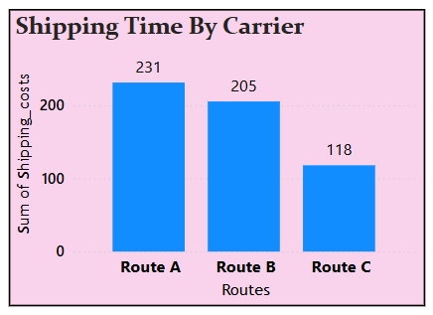
Shipping & logistics phase analysis
1. Shipping time by carrier
The bar chart titled "Shipping Time By Carrier" displays the sum of shipping costs for three different routes: Route A, Route B, and Route C.
The chart shows that Route A has the highest shipping cost at 231, indicating it might be the least cost-efficient route among the three. This high cost could be due to factors like longer distances. Route B follows with a shipping cost of 205, which, while lower than Route A, is still relatively high. This suggests that Route B also has significant cost implications, potentially due to similar factors affecting Route A.
Route C has the lowest shipping cost at 118, making it the most cost-efficient route. This lower cost could be due to shorter distances, This analysis is essential for optimizing shipping operations. By understanding the cost implications of each route, businesses can make informed decisions about which routes to prioritize. For instance, if minimizing shipping costs is a primary goal, focusing on Route C might be beneficial. Conversely, if Routes A and B are necessary for other logistical reasons, exploring ways to reduce their costs would be crucial.
Fig 29. Shipping time By Carrier

Slide 44
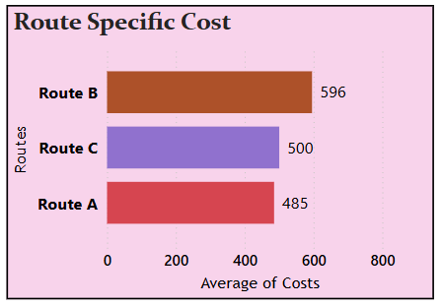
Shipping & logistics phase analysis
2. Route specific cost
The bar chart titled "Route Specific Cost" compares the average costs associated with three different routes: Route A, Route B, and Route C. From the chart, we can observe that Route B has the highest average cost at 596, indicating that this route may be the least cost-effective. This higher cost could be attributed to factors such as longer distances, more expensive logistics, or higher fuel consumption.
Route C follows with an average cost of 500, which, while lower than Route B, still represents a significant expenditure. This suggests that Route C also has considerable cost implications, possibly due to similar factors affecting Route B.
Route A has the lowest average cost at 485, making it the most cost-efficient route among the three. This lower cost could be due to shorter distances, more efficient logistics, or other cost-saving measures in place.
This analysis highlights the importance of understanding the cost implications of different routes. By identifying the most and least cost-effective routes, businesses can make informed decisions to optimize their shipping operations.
Fig 30. Route Specific Cost

Slide 45
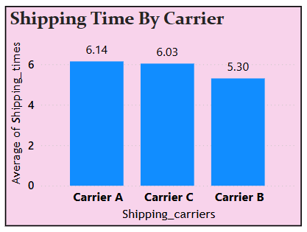
Shipping & logistics phase analysis
3. Shipping time by carrier
The bar chart titled "Shipping Time By Carrier" provides insights into the average shipping times for three different carriers. Carrier B demonstrates the shortest average shipping time at 5.30, indicating it is the most efficient carrier in terms of delivery speed. This suggests that Carrier B might have streamlined logistics processes, faster transportation methods, or better route optimization.
Carrier C follows closely with an average shipping time of 6.03, making it a relatively efficient option, but still slightly slower compared to Carrier B. This indicates that while Carrier C is also efficient, there might be areas for improvement to match the performance of Carrier B.
Carrier A has the longest average shipping time at 6.14, highlighting that it is the least efficient carrier among the three. This could be due to longer transit routes, delays in processing, or less optimized logistics practices.
This analysis is crucial for businesses aiming to optimize their shipping operations. By understanding the shipping times of different carriers, businesses can make informed decisions about which carrier to choose to ensure timely delivery and customer satisfaction.
Fig 31. Shipping Time by Carrier

Slide 46
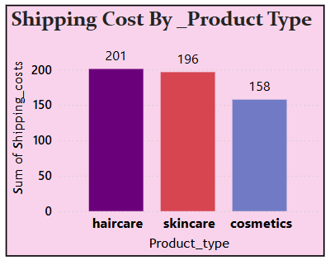
Shipping & logistics phase analysis
4. Shipping Cost by product type
The bar chart titled "Shipping Cost By Product Type" provides a visual representation of the sum of shipping costs for three different product types. Haircare products have the highest shipping costs, totaling 201. This suggests that haircare products may involve heavier or bulkier items, leading to higher shipping expenses.
Skincare products follow closely with shipping costs amounting to 196. While slightly lower than haircare, the shipping cost for skincare products is still significant. This indicates that skincare products may also require careful handling or special packaging, contributing to the overall shipping costs.
Cosmetics have the lowest shipping costs at 158. This lower cost could be due to the typically smaller and lighter nature of cosmetic products, resulting in reduced shipping expenses. This information can help businesses focus on maintaining efficient shipping practices for cosmetics while leveraging the cost advantage.
Fig 32. Shipping cost By Product type

Slide 47
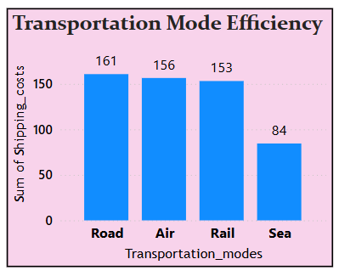
Shipping & logistics phase analysis
5. Transportation mode efficiency
The bar chart titled "Transportation Mode Efficiency" compares the sum of shipping costs for four different transportation modes. From the chart, we observe that Sea transportation has the lowest shipping cost at 84, making it the most cost-efficient mode among the four. This suggests that sea transportation is the most economical option, likely due to its ability to carry large volumes of goods over long distances at a lower cost per unit.
Rail transportation follows with a shipping cost of 153, indicating it is more cost-efficient than air and road transportation but less so than sea transportation. Rail is often used for transporting bulk goods across large land areas, and its moderate cost reflects this capability.
Air transportation has a shipping cost of 156, slightly higher than rail. While air transportation is known for its speed, the relatively higher cost is due to the expenses associated with fuel, maintenance, and logistics of air travel. This mode is suitable for high-value or time-sensitive goods.
Road transportation has the highest shipping cost at 161, making it the least cost-efficient mode among the four. The high cost can be attributed to factors such as fuel prices, tolls, and maintenance costs.
Fig 33. Transportation Mode Efficiency

Slide 48
THANK YOU

